Slide 1
External Sorting
CS 400/600 – Data Structures

Slide 2
Motivation
Sometimes the data to sort are too large to fit in memory.
Recall from our discussions on disk access speed that the primary rule is:
Minimize the number of disk accesses!

Slide 3
Double Buffering
It is often the case that a system will maintain at least two input and two output buffers:
  While one input buffer is being read, the previous one is being processed
  While one output buffer is being filled, the other is being written

Slide 4
Model of External Computation
Secondary memory is divided into equal-sized blocks (512, 1024, etc…)
A basic I/O operation transfers the contents of one disk block to/from main memory.
Under certain circumstances, reading blocks of a file in sequential order is more efficient. (When?)
Primary goal is to minimize I/O operations.
Assume only one disk drive is available.
Notes:
For sequential search to be more efficient than random access to the file
adjacent logical blocks of the file must be physically adjacent.
There must be no competition for the I/O head, either with another process, or within the same process (such as thrashing between and input buffer and an output buffer).

Slide 5
Key Sorting
Often, records are large, keys are small.
  Ex: Payroll entries keyed on ID number
Approach 1: Read in entire records, sort them, then write them out again.
Approach 2: Read only the key values, store with each key the location on disk of its associated record.
After keys are sorted the records can be read and rewritten in sorted order.
Notes:
Usually the records are not rewritten in sorted order.
(1) It is expensive (random access to all records).
(2) If there are multiple keys, there is no single “correct” order.

Slide 6
Simple External Mergesort (1)
Quicksort requires random access to the entire set of records.
Better: Modified Mergesort algorithm.
  Process n elements in Θ(log n) passes.
A group of sorted records is called a run.
Notes:
Usually the records are not rewritten in sorted order.
(1) It is expensive (random access to all records).
(2) If there are multiple keys, there is no single “correct” order.

Slide 7
Simple External Mergesort (2)
Split the file into two files.
Read in a block from each file.
Take first record from each block, output them in sorted order.
Take next record from each block, output them to a second file in sorted order.
Repeat until finished, alternating between output files. Read new input blocks as needed.
Repeat steps 2-5, except this time input files have runs of two sorted records that are merged together.
Each pass through the files provides larger runs.
Notes:
Usually the records are not rewritten in sorted order.
(1) It is expensive (random access to all records).
(2) If there are multiple keys, there is no single “correct” order.

Slide 8
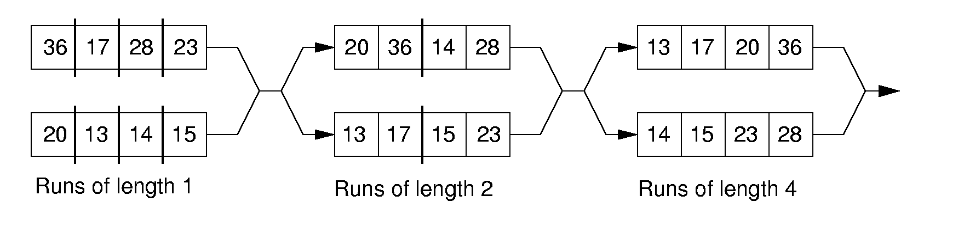
Simple External Mergesort (3)
Notes:
Usually the records are not rewritten in sorted order.
(1) It is expensive (random access to all records).
(2) If there are multiple keys, there is no single “correct” order.

Slide 9
Problems with Simple Mergesort
Is each pass through input and output files sequential?
What happens if all work is done on a single disk drive?
How can we reduce the number of Mergesort passes?
In general, external sorting consists of two phases:
  Break the files into initial runs
  Merge the runs together into a single run.
Notes:
The passes are sequential. But, on a single disk drive, competition for the I/O head eliminates this advantage.
But, we can get a massive improvement by reading in a block, or several blocks, and using an in-memory sort to create the initial runs.

Slide 10
Breaking a File into Runs
General approach:
  Read as much of the file into memory as possible.
  Perform an in-memory sort.
  Output this group of records as a single run.

Slide 11
Replacement Selection (1)
Break available memory into an array for the heap, an input buffer, and an output buffer.
Fill the array from disk.
Make a min-heap.
Send the smallest value (root) to the output buffer.

Slide 12
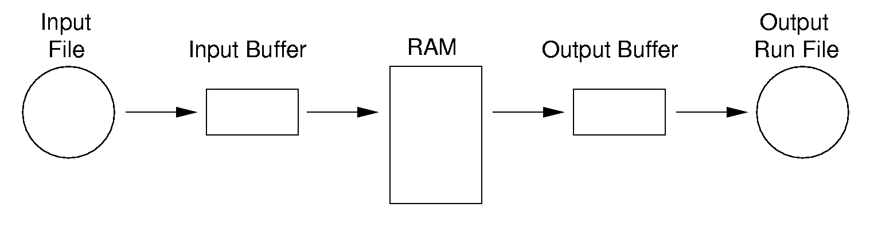
Replacement Selection (2)
If the next key in the file is greater than the last value output, then
  Replace the root with this key
else
  Replace the root with the last key in the array
  Add the next record in the file to a new heap (actually, stick it at the end of the array).

Slide 13
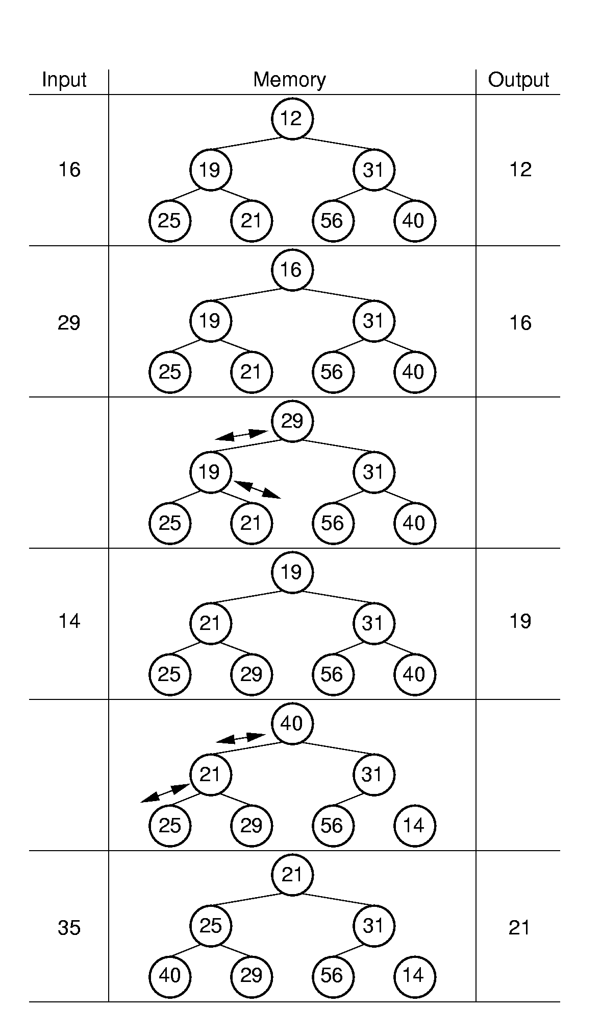
Replacement Selection Example

Slide 14
Initial runs
It can be shown that the average run length for this algorithm will be 2M (where M is the size of memory)
  Snowplow argument
Just reading in and sorting an array would only get a run of size M
Now we just need to merge the initial runs

Slide 15
Multiway Merge (1)
With replacement selection, each initial run is several blocks long.
Assume each run is placed in separate file.
Read the first block from each file into memory and perform an r-way merge.
When a buffer becomes empty, read a block from the appropriate run file.
Each record is read only once from disk during the merge process.

Slide 16
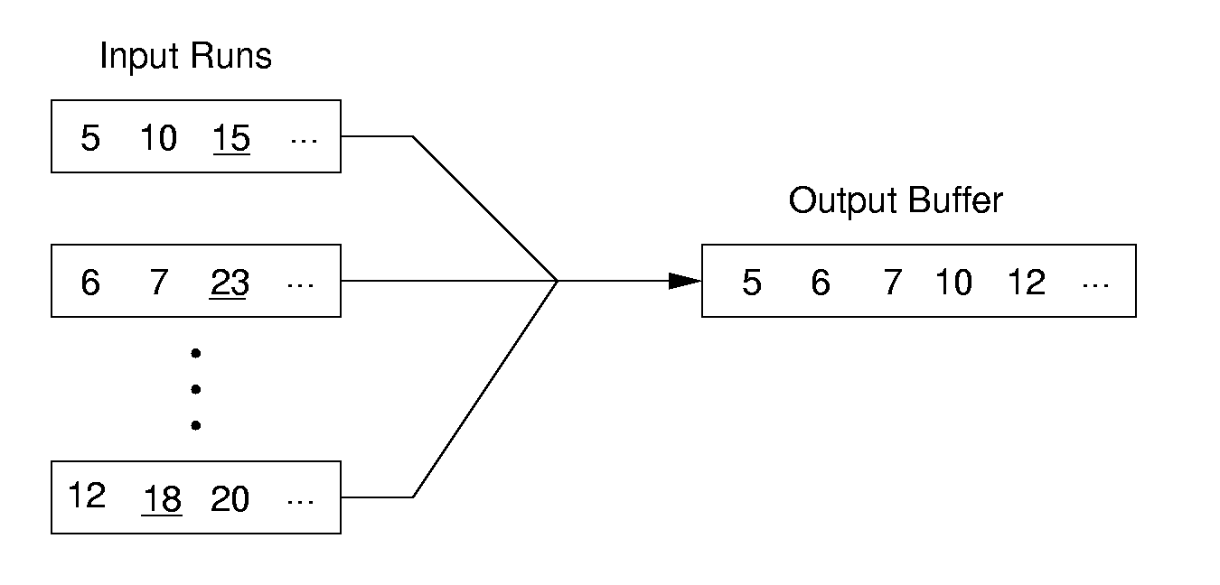
Multiway Merge (2)
In practice, use only one file and seek to appropriate block.

